Slide 1


The Profile
(aka Google Scholar Citations)
Disember 2015
Prepared by: Syaiful Hisyam Saleh
Research Asst. Unit, Customer Service Dept
Library of Univ. Sultan Zainal Abidin (UniSZA)

Slide 2
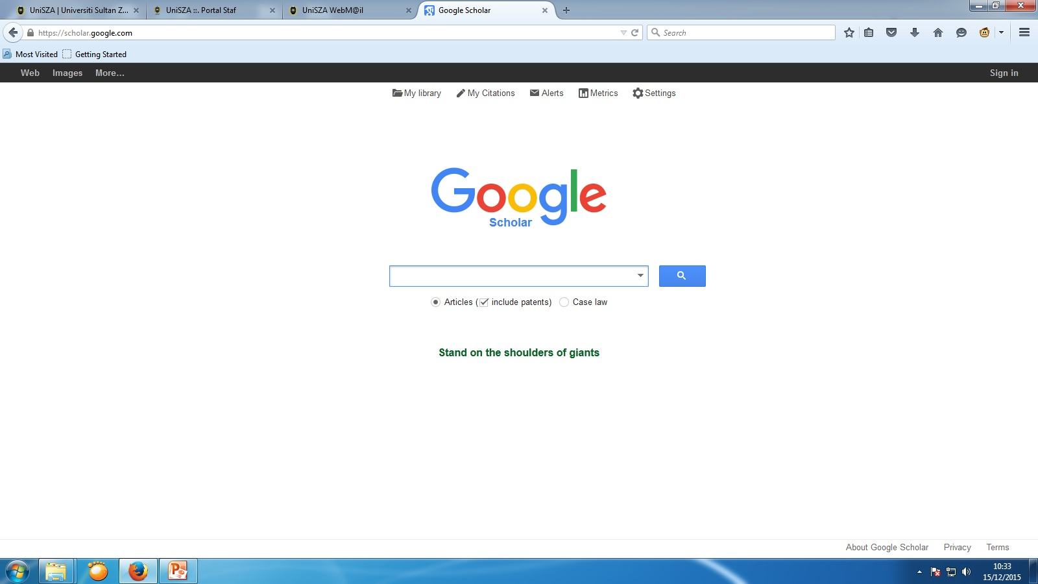
Sign in with your gmail account

Slide 3
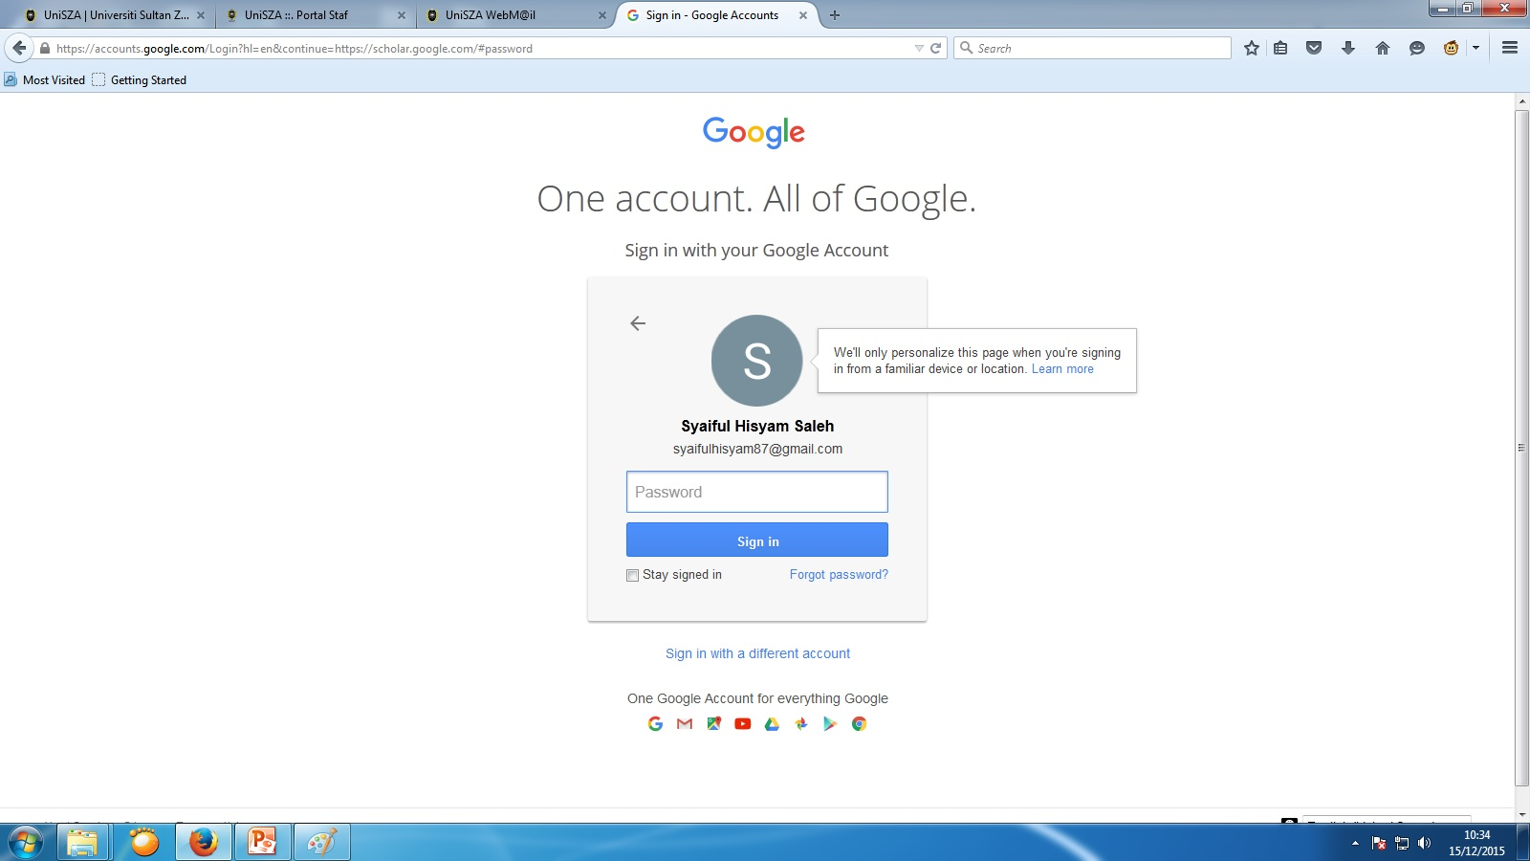

Slide 4

Signed in
Click on My Citations

Slide 5
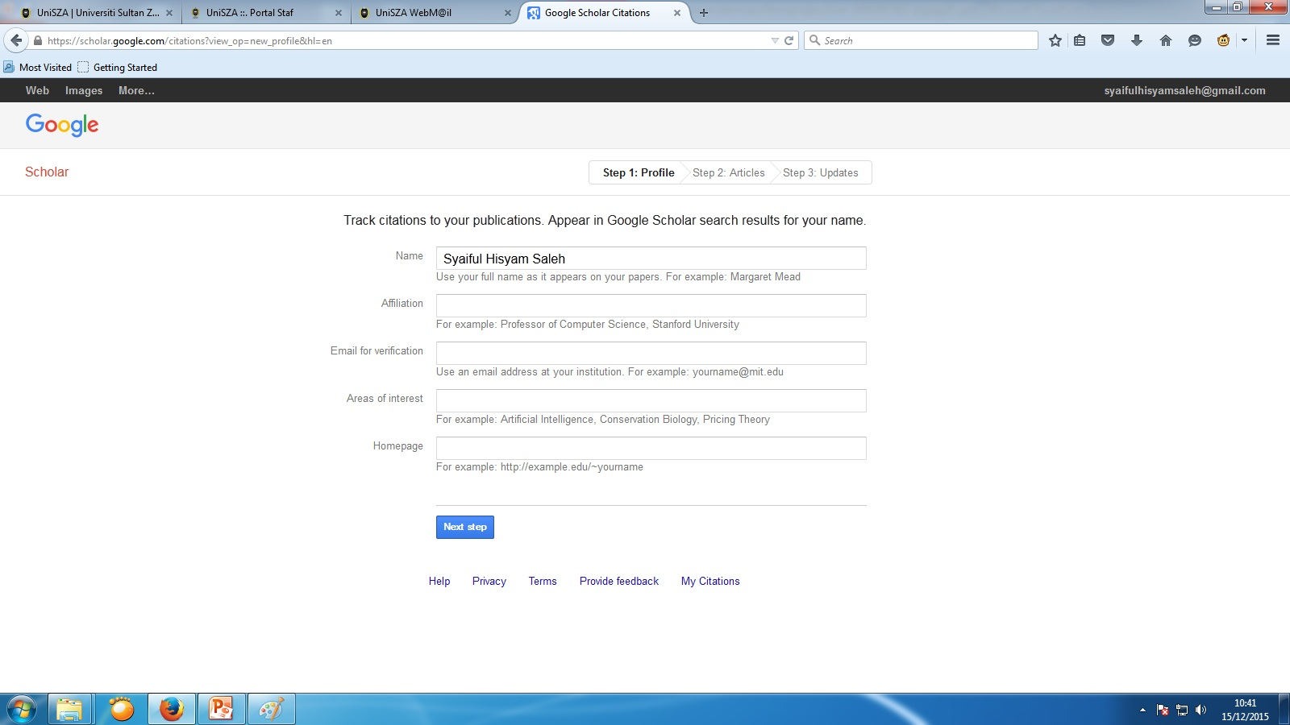
Your details
Your post & Affiliation
Your UniSZA email
Max of 5 interests
UniSZA Website Address

Slide 6
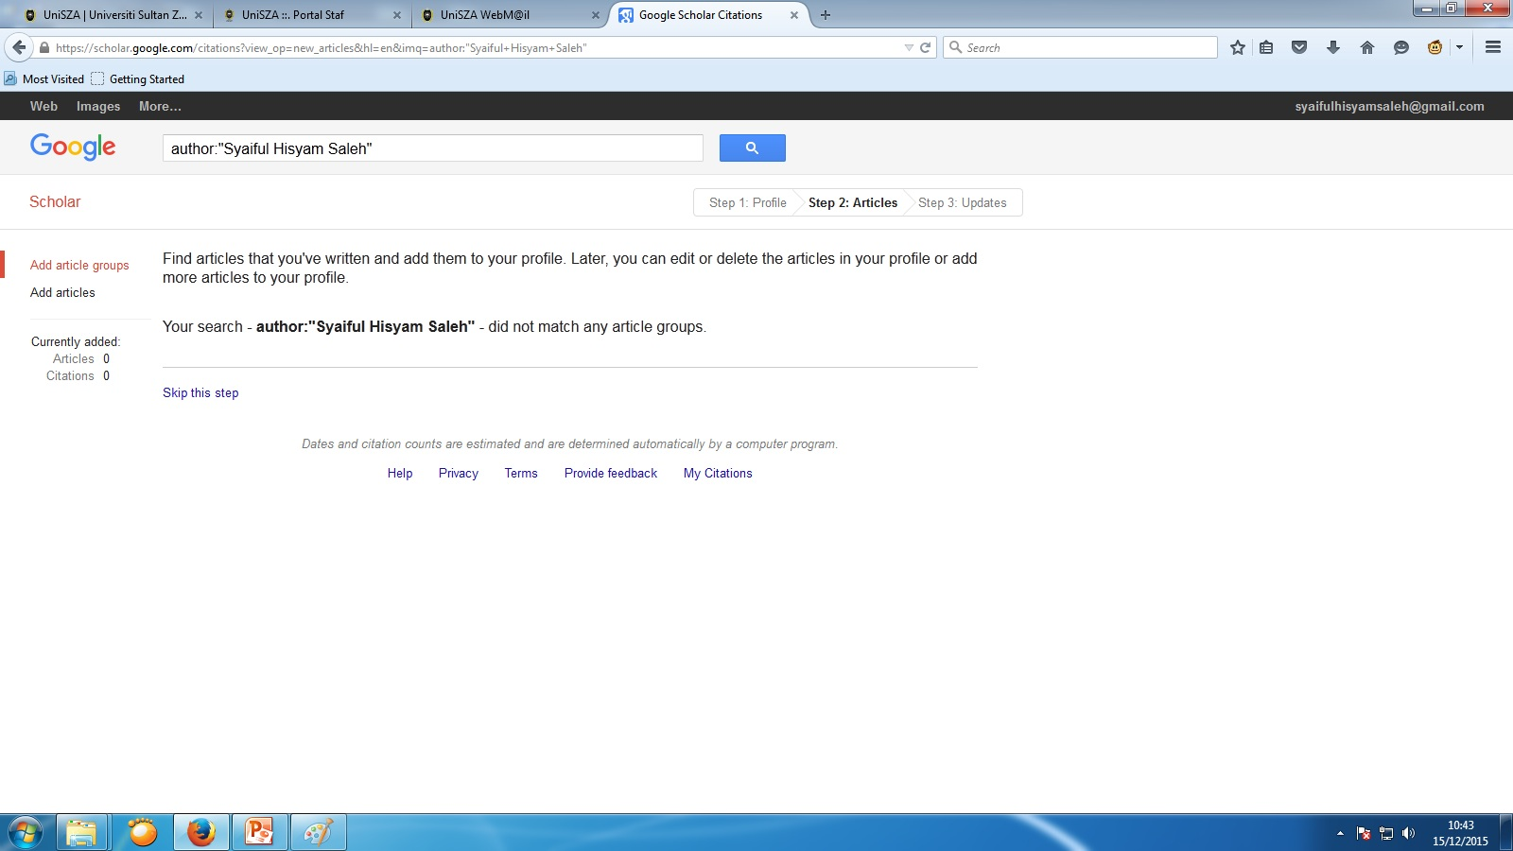
Find your articles
On this page, you see groups of articles written by people with names similar to yours. Click “add all articles” next to each article group that is yours, or “See all articles” to add specific articles from that group.

Slide 7
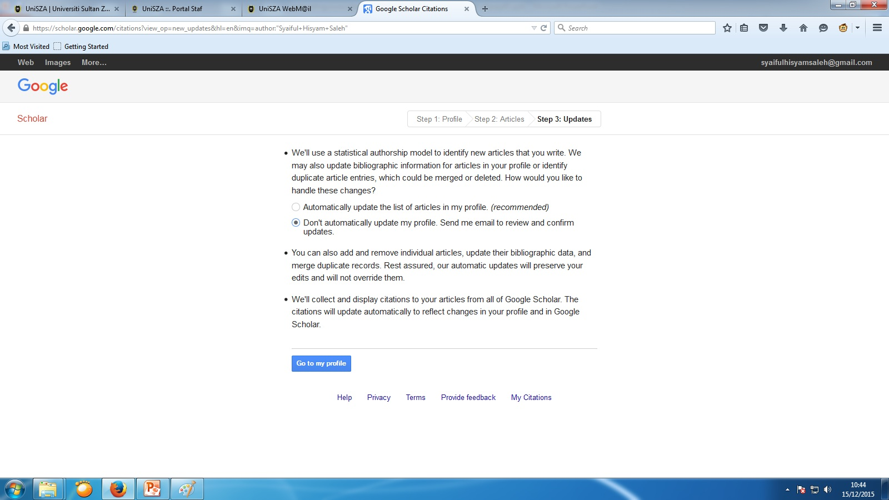
Decide on automatic updates or manual updates

Slide 8
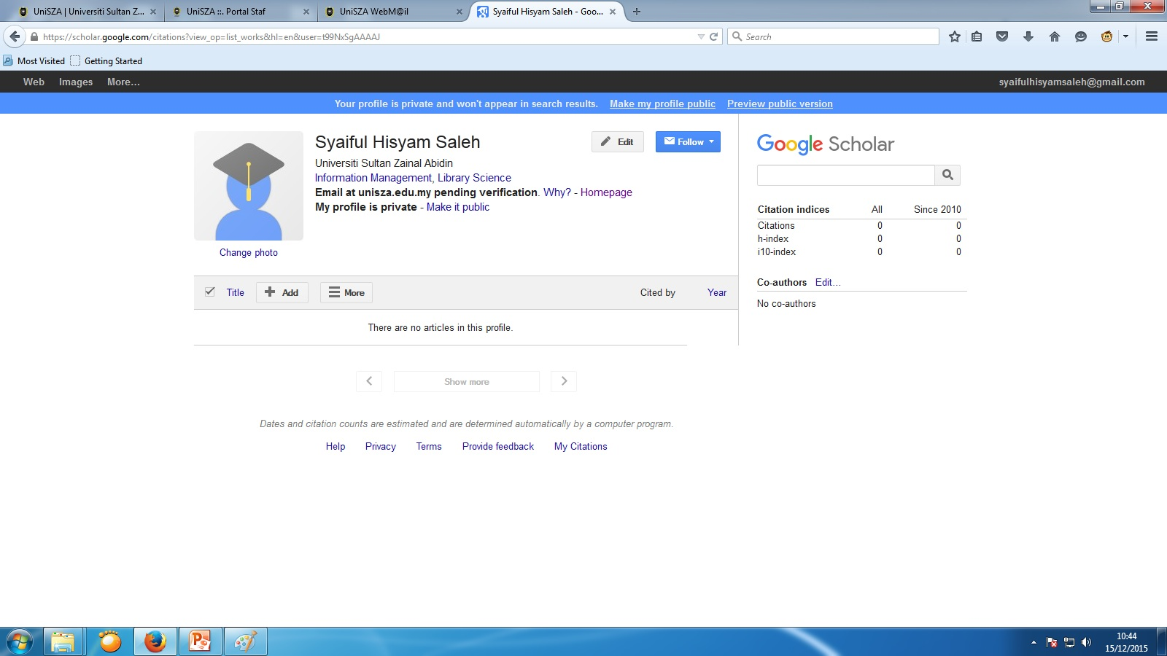
Verify your UniSZA e-mail
Make your profile public
Customise your profile

Slide 9
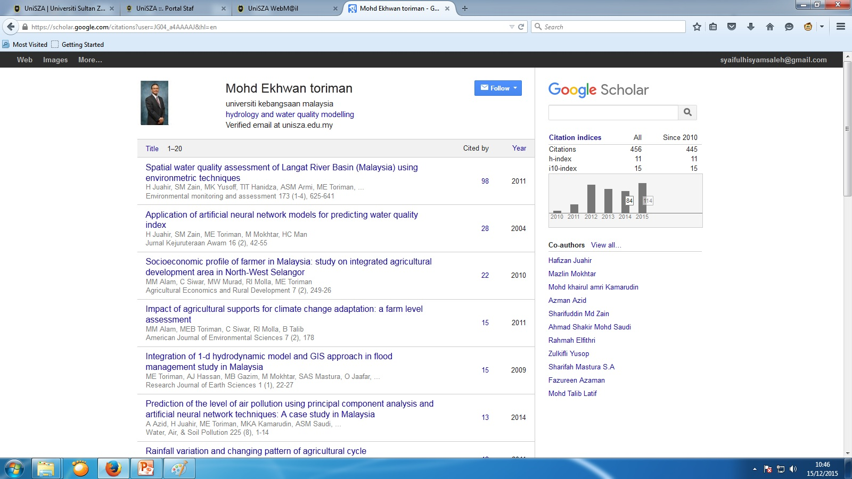
Public Profile

Slide 10
IN A NUTSHELL
Sign into Google Scholar with your gmail
Click on My Citations
Create your profile
Find your articles
Decide on automatic/manual updates
Verify your e-mail
Update your profile
Decide on public/private profile

